Slide 1
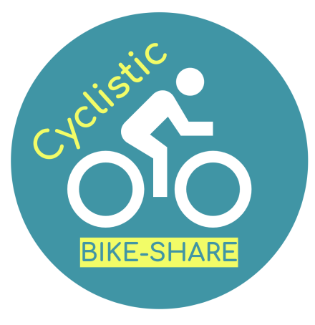
CYCLISTIC BIKE-SHARE
Marketing analyst team report
Presented by: NONOS GWETH Yvan Gontran

Slide 2
INTRODUCTION
Problem statement: How do annual members and casual riders use Cyclistic bikes differently?
Business Task/ Aim: identify differences in terms of use between annual members and casual riders
Identify data useful for our analysis
Highlight the different customer categories by type of use, as well as their ratio
Objectives:
Shows average daily distances by customer category
Highlight bike preferences

Slide 3
GENERALITIES
Cyclistic is a bike-share company based in Chicago. The company features more than 5,800 bicycles and 600 docking stations.
Cyclistic’s marketing strategy relied on building general awareness and appealing to broad consumer segments
Their different pricing plans are: single-ride passes, full-day passes, and annual memberships
Customers who purchase single-ride or full-day passes are referred to as casual riders. Customers who purchase annual memberships are Cyclistic members.

Slide 4
since annual members are more profitable for the company than occasional cyclists, even though flexible pricing attracts many customers, the marketing manager believes that retaining occasional cyclists rather than launching a campaign to attract new customers will be the key to the company's growth.
The Manager has set a clear goal: Design marketing strategies aimed at converting casual riders into annual members.
In order to do that, however, the marketing analyst team needs to better understand how annual members and casual riders differ, why casual riders would buy a membership, and how digital media could affect their marketing tactics.

Slide 5
Data
The case study is available Here
The data has been downloaded on my computer, but can be found here
The data has 13 columns and 49623 rows
The data has been made available by Motivate International Inc. under this license
We use data from 202102-divvy-tripdata.zip for the month of february 2021

Slide 6
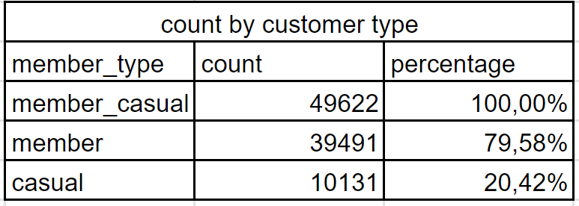
Results
The data analysis process has been performed using Google Sheet
show the percentage of each customer category

Slide 7
Results
identify and group the most useful columns, namely : ride_id, rideable_type, start_at, end_at, member_ casual
calculate the duration of each ride
Set the days of the week between 1(Sunday) and 7(Saturday) group them into a column

Slide 8
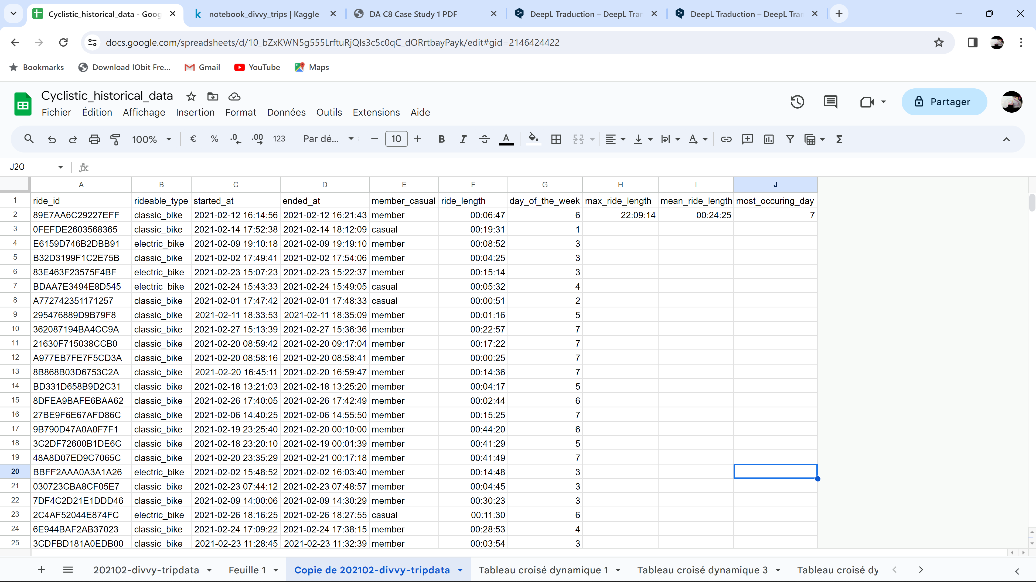

Slide 9
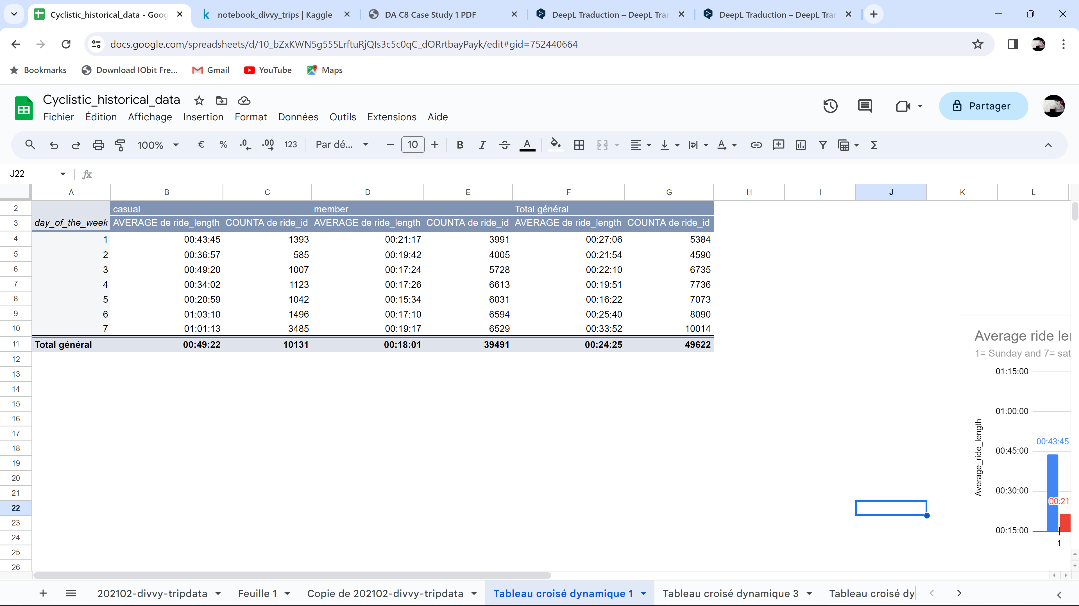
highlight the average ride length by customer type

Slide 10
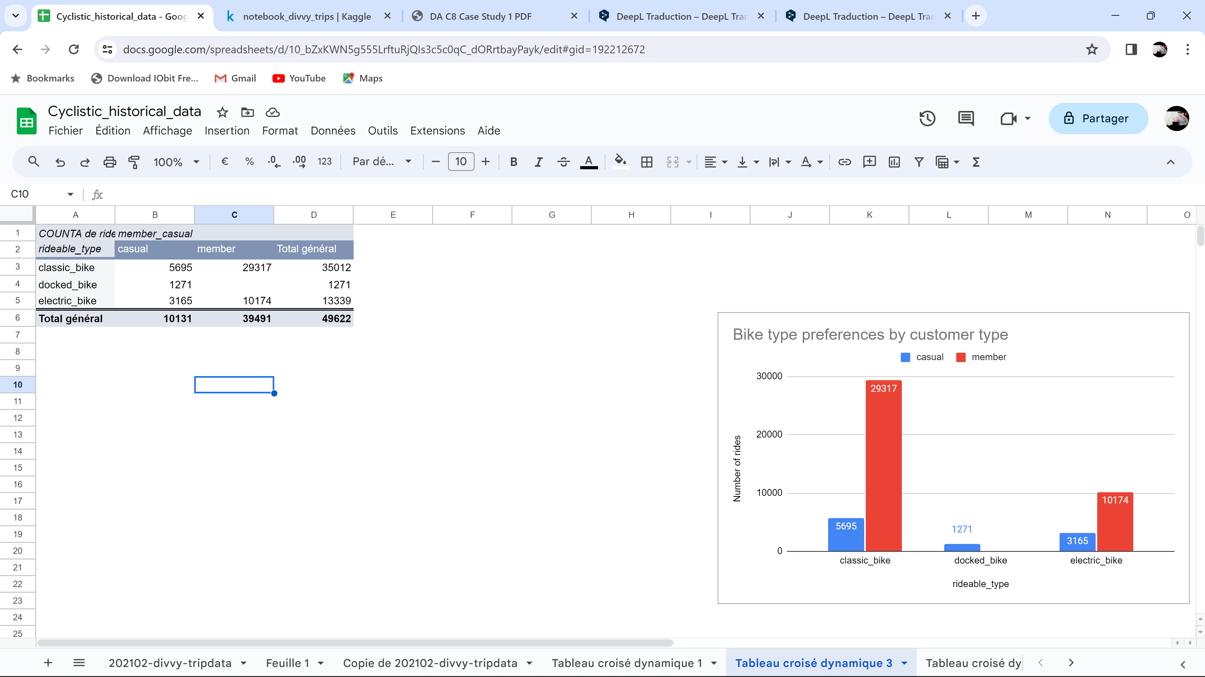
highlight the most popular types of bikes

Slide 11
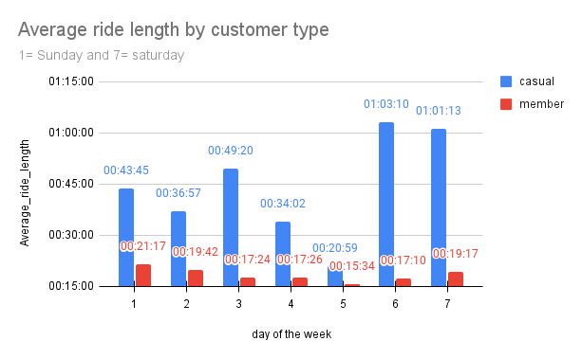

Slide 12
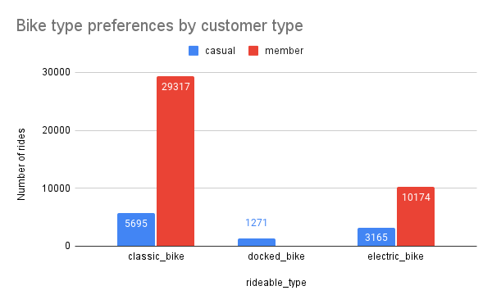

Slide 13
Discussion
The analysis shows that :
members represent about 80% of the customer base, while casuals account for about 20%.
Observation of average journey times when using bicycles shows that whatever the day of the week, casuals use cyclistic bicycles for longer journeys.
when it comes to preferences in terms of the type of bikes used, members largely prefer classic bikes to e-bikes, and hardly use docked bikes at all, while casuals use all types of bike.

